Slide 1

Modern Programming Tools And Techniques-I
Lecture 11: String Handling
Lovely Professional University, Punjab

Slide 2
Introduction
Every string we create is actually an object of type String.
String constants are actually String objects.
Example:
System.out.println("This is a String, too");
Objects of type String are immutable i.e. once a String object is created, its contents cannot be altered.
String Constant

Slide 3
Why String is Immutable or Final?
String has been widely used as parameter for many java classes e.g.
for opening network connection we can pass hostname and port number as string ,
we can pass database URL as string for opening database connection,
we can open any file in Java by passing name of file as argument to File I/O classes.
In case if String is not immutable , this would lead serious security threat , means some one can access to any file for which he has authorization and then can change the file name either deliberately or accidentally and gain access of those file.

Slide 4
Introduction
In java, four predefined classes are provided that either represent strings or provide functionality to manipulate them. Those classes are:
  String
  StringBuffer
  StringBuilder
  StringTokenizer
  String, StringBuffer, and StringBuilder classes are defined in java.lang package and all are final.
  All three implement the CharSequence interface.

Slide 5
Why String Handling?
String handling is required to perform following operations on some string:
compare two strings
search for a substring
concatenate two strings
change the case of letters within a string

Slide 6
Creating String objects
class StringDemo
{
public static void main(String args[])
{
String strOb1 = “Ravi";
String strOb2 = “LPU";
String strOb3 = strOb1 + " and " + strOb2;
System.out.println(strOb1);
System.out.println(strOb2);
System.out.println(strOb3);
}
}

Slide 7
String Class
String Constructor:
public String ()
public String (String)
public String (char [])
public String (byte [])
public String (char [], int offset, int no_of_chars)
public String (byte [], int offset, int no_of _bytes)

Slide 8
Examples
char [] a = {'c', 'o', 'n', 'g', 'r', 'a', 't', 's'};
byte [] b = {82, 65, 86, 73, 75, 65, 78, 84};
String s1 = new String (a); System.out.println(s1);
String s2 = new String (a, 1,5); System.out.println(s2);
String s3 = new String (s1); System.out.println(s3);
String s4 = new String (b); System.out.println(s4);
String s5 = new String (b, 4, 4); System.out.println(s5);

Slide 9
String Concatenation
Concatenating Strings:
String age = "9";
String s = "He is " + age + " years old.";
System.out.println(s);
Using concatenation to prevent long lines:
String longStr = “This could have been” +
“a very long line that would have” +
“wrapped around. But string”+ “concatenation prevents this.”;
System.out.println(longStr);

Slide 10
String Concatenation with Other Data Types
We can concatenate strings with other types of data.
Example:
int age = 9;
String s = "He is " + age + " years old.";
System.out.println(s);

Slide 11
Methods of String class
length() → returns length of string
charAt() → used to obtain char from specified index
getChars() → used to obtain set of characters
toCharArray() → returns character array from string contents
equals() → used to compare strings for equality
equalsIgnoreCase() → perform comparison that ignores case
startsWith() → whether a String begins with a specified string
endsWith() → whether a String ends with a specified string
compareTo() → whether a string is greater or less than other
indexOf() → searches for 1st occurrence of character or substring
lastIndexOf() → searches for last occurrence of character or substring
substring() → used to extract a part of a string.
concat() → used to concatenate two strings
replace() → replaces all occurrence of character(s) with another
trim() → remove leading and trailing whitespaces
toLowerCase() → returns string which contains lower case letters
toUpperCase() → returns string which contains upper case letters

Slide 12
Methods of String class
String Length:
length() returns the length of the string i.e. number of characters.
int length()
Example:
char chars[] = { 'a', 'b', 'c' };
String s = new String(chars);
System.out.println(s.length());
1) Wap to find no. of characters present in a sentence entered by the user at run-time.

Slide 13
Character Extraction
charAt(): used to obtain the character from the specified index from a string.
public char charAt (int index);
Example:
char ch;
ch = "abc".charAt(1);
1) Wap to take character input from user
2) Wap to count no. of times a character appears in string
3) Wap to count no. of vowels present in string-sentence and print their frequencies.

Slide 14
Methods Cont…
getChars(): used to obtain set of characters from the string.
public void getChars(int start_index, int end_index, char[], int offset)
Example: String s = “KAMAL”;
char b[] = new char [10];
b[0] = ‘N’; b[1] = ‘E’;
b[2] = ‘E’; b[3] = ‘L’;
s.getChars(0, 4, b, 4);
System.out.println(b);
1) Wap to extract string characters from index 3 to 7 in a character array.

Slide 15
Methods Cont…
toCharArray(): returns a character array initialized by the contents of the string.
public char[] toCharArray();
Example: String s = “India”;
char c[] = s.toCharArray();
for (int i=0; i<c.length; i++)
{
if (c[i]>= 65 && c[i]<=90)
c[i] += 32;
System.out.print(c[i]);
}
Wap to convert string to character array
Wap to count no. of capital alphabet-letters in a string-sentence.

Slide 16
String Comparison
equals(): used to compare two strings for equality.
Comparison is case-sensitive.
public boolean equals (Object str)
Wap to compare username entered by user
equalsIgnoreCase( ): To perform a comparison that ignores case differences.
Wap to compare email-address entered by user
Note:
This method is defined in Object class and overridden in String class.
equals(), in Object class, compares the value of reference not the content.
In String class, equals method is overridden for content-wise comparison of two strings.

Slide 17
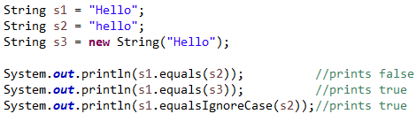
Example

Slide 18
String Comparison
startsWith( ) and endsWith( ):
  The startsWith( ) method determines whether a given String begins with a specified string.
  Conversely, endsWith( ) determines whether the String in question ends with a specified string.
boolean startsWith(String str)
boolean endsWith(String str)
1) Wap to find out whether a sentence starts with “Hello” and ends with “Good bye”.

Slide 19
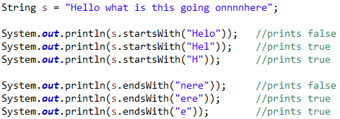
Example

Slide 20
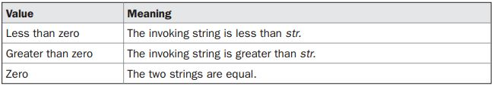
String Comparison
compareTo( ):
A string is less than another if it comes before the other in dictionary order.
A string is greater than another if it comes after the other in dictionary order.
int compareTo(String str)
1) Wap to sort array of Strings

Slide 21
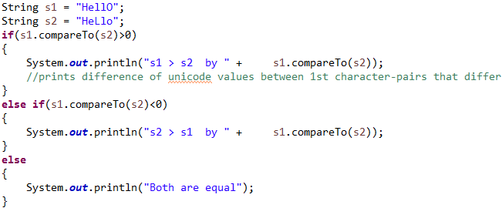
Example
Output: s1 > s2 by 32

Slide 22
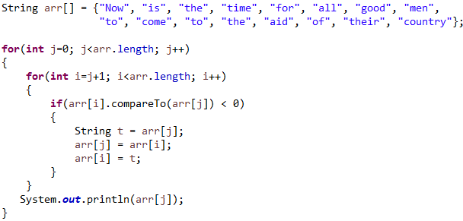
Example (sort array of Strings)

Slide 23
Searching Strings
The String class provides two methods that allow us to search a string for a specified character or substring:
indexOf( ): Searches for the first occurrence of a character or substring.
int indexOf(int ch)
lastIndexOf( ): Searches for the last occurrence of a character or substring.
int lastIndexOf(int ch)
To search for the first or last occurrence of a substring, use
int indexOf(String str)
int lastIndexOf(String str)

Slide 24
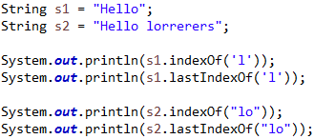
Example
Output: 2 3 3 6

Slide 25
We can specify a starting point for the search using these forms:
int indexOf(int ch, int startIndex)
int lastIndexOf(int ch, int startIndex)
int indexOf(String str, int startIndex)
int lastIndexOf(String str, int startIndex)
Here, startIndex specifies the index at which point the search begins.
For indexOf( ), the search runs from startIndex to the end of the string.
For lastIndexOf( ), the search runs from startIndex to zero.
Wap to find out how many times a particular character appears in sentence using indexOf() method.
Wap to find out how many times a particular string appears in sentence using indexOf method().

Slide 26
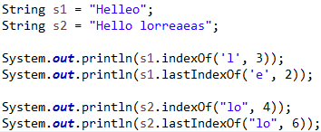
Example
Output: 3 1 6 6

Slide 27
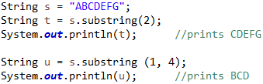
Modifying a String
Because String objects are immutable, whenever we want to modify a String, we must either copy it into a StringBuffer or StringBuilder, or use one of the following String methods, which will construct a new copy of the string with modifications.
substring(): used to extract a part of a string.
public String substring (int start_index)
public String substring (int start_index, int end_index)
Example:
Wap to extract a sub-string (“Lovely”) if it is present in a sentence.

Slide 28
concat( ): used to concatenate two strings.
String concat(String str)
This method creates a new object that contains the invoking string with the contents of str appended to the end.
concat( ) performs the same function as +.
Example:
String s1 = "one";
String s2 = s1.concat("two");
It generates the same result as the following sequence:
String s1 = "one";
String s2 = s1 + "two";

Slide 29
replace( ): The replace( ) method has two forms.
The first replaces all occurrences of one character in the invoking string with another character. It has the following general form:
String replace(char original, char replacement)
Here, original specifies the character to be replaced by the character specified by replacement.
Example: String s = "Hello".replace('l', 'w');
The second form of replace( ) replaces one character sequence with another. It has this general form:
String replace(CharSequence original, CharSequence replacement)
Wap to replace “Hello” with “Hello sir” in a sentence using replace() method.
Wap to replace ‘g’ with ‘G’ in sentence:- “god is the creator of universe and we should worship god”

Slide 30
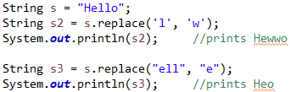
Example

Slide 31
Exercise
Write a program which prompts the user to enter a paragraph in Present continuous tense and display it in Past Continuous.

Slide 32
trim( )
The trim( ) method returns a copy of the invoking string from which any leading and trailing whitespace has been removed.
String trim( )
Example:
String s = " Hello World ".trim();
This puts the string “Hello World” into s.
1) Wap to store username of a person after trimming the whitespaces when he/she enters it.

Slide 33
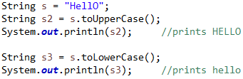
Changing the Case of Characters Within a String
toLowerCase() & toUpperCase()
Both methods return a String object that contains the uppercase or lowercase equivalent of the invoking String.
String toLowerCase( )
String toUpperCase( )
Example:
1) Wap to compare email-id of a person (when he/she enters it) to find out if it is correct or not.

Slide 34
Split()
public String [ ] split ( String regex )
public String [ ] split ( String regex, int limit )
Returns: An array of strings computed by splitting the given string.
Throws: PatternSyntaxException - if the provided regular expression’s syntax is invalid.
Example:
String str = "have-fun-in-java@blogspot@in";
String [] s = str.split("-", -2);
for(String x: s) System.out.println(x);

Slide 35
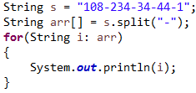
Example:
Output: 108
234
34
44
1

Slide 36
Limit parameter can have 3 values:
limit > 0 : If this is the case then the pattern will be applied at most limit-1 times, the resulting array’s length will not be more than n, and the resulting array’s last entry will contain all input beyond the last matched pattern.
limit < 0 : In this case, the pattern will be applied as many times as possible, and the resulting array can be of any size.
limit = 0 : In this case, the pattern will be applied as many times as possible, the resulting array can be of any size, and trailing empty strings will be discarded.

Slide 37
split( )
It breaks a given string against given regular expression and returns String array.
String[] split(String regex)
Example:
Output: 108
234
34
44
1

Slide 38
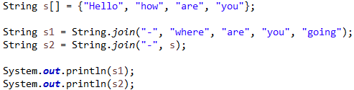
join( )
Returns a new String composed of copies of the CharSequence elements joined together with a copy of the specified delimiter
public static String join(CharSequence delimiter, CharSequence... elements)
Example:
Output:
where-are-you-going
Hello-how-are-you

Slide 39


